Slide 1

Group-15
Pitch Deck
Use case 3 - Autonomous Insurance Quote Agents
05-03-2026

Slide 2
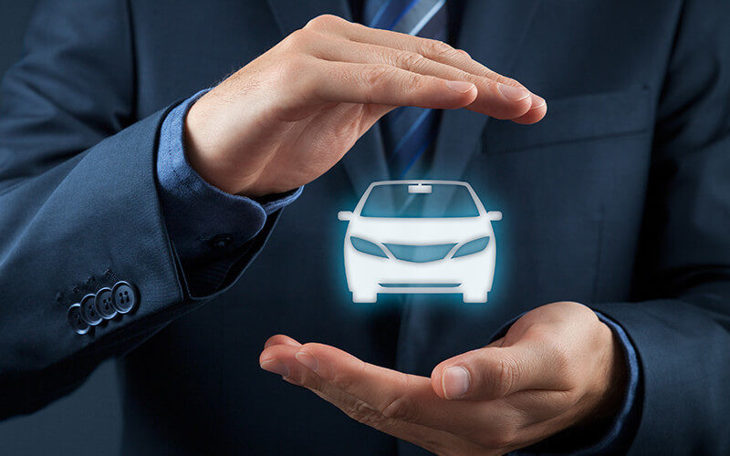
Problem Statement
Insurance companies generate thousands of quotes every day, but only a small percentage convert into actual policies.
01
Large number of unconverted insurance quotes
02
High operational cost for insurance companies
03
low response time to customers
04
Manual investigation required for each quote

Slide 3
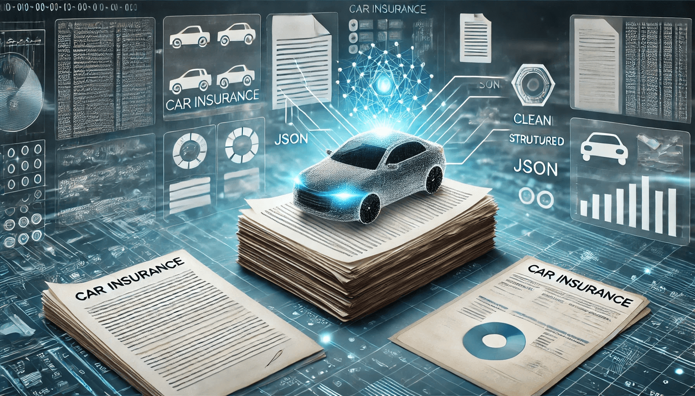
Our Solution
We developed an AI-powered Autonomous Quote Decision System.
The system automatically analyzes insurance quotes and predicts the best action.
01
02
Profiles the risk level of customers
Predicts conversion probability
03
04
The system works through a multi-agent AI pipeline that processes quotes intelligently.
This reduces manual work and improves decision speed.
Suggests optimal premium pricing
Routes the quote to the correct decision

Slide 4
System Architecture
Agent 1 — Risk Profiler
Analyzes driver and vehicle data to determine risk level.
↓
Agent 2 — Conversion Predictor
Predicts probability of policy conversion.
↓
Agent 3 — Premium Advisor
Suggests optimal premium adjustments.
↓
Agent 4 — Decision Router
Final decision:
Auto approve
Agent follow-up
Escalate to underwriter
Our system uses a Multi-Agent AI Pipeline.
Each agent performs a specialized task and passes the output to the next agent.
This architecture enables automated and intelligent decision-making in insurance quote management.

Slide 5
Technology Stack
Our solution integrates modern web technologies with machine learning to build an intelligent insurance decision system.
Frontend
Backend
HTML
CSS
JavaScript
Used to create an interactive web interface where users enter insurance quote details and view AI predictions.
Python
Flask API
Handles communication between the user interface and machine learning models.
Machine Learning
Explainable AI
Scikit-learn
Pandas
NumPy
Used for data preprocessing, feature engineering, and predictive modeling.
SHAP (SHapley Additive Explanations)
Provides insights into which features influence AI decisions.

Slide 6
System Workflow
01
User Input
03
AI Model Analysis
The user enters insurance quote details through the web interface such as:
Number of drivers
Annual miles driven
Coverage type
Customer salary category
Quoted premium
Multiple AI agents analyze the quote to determine risk level, predict conversion probability, and evaluate premium suitability.
04
Decision Generation
Based on the AI analysis, the system generates a final decision and recommended premium.
Data Processing
02
Results Display
05
The input data is sent to the Python backend where it is preprocessed and prepared for machine learning analysis.
The results are instantly displayed on the dashboard showing:
Risk Profile
Conversion Probability
Suggested Premium
Final Decision

Slide 7
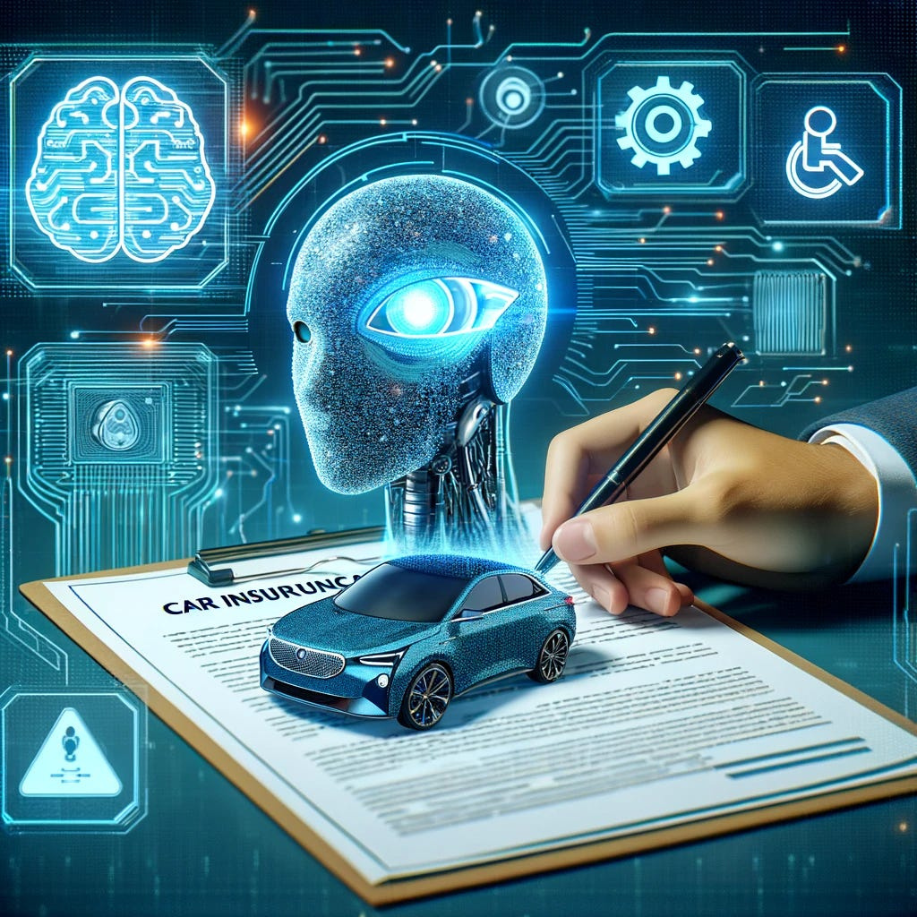
Key Features
Autonomous AI Decision System
Multi-agent AI pipeline
• Automated insurance quote analysis
• Conversion probability prediction
• Intelligent premium recommendation
• Real-time dashboard interface
The system provides insights into why a decision was made, improving transparency and trust.

Slide 8
AI DAY HACKATON
Our Team
Prem Chand Mahanta
T.Akhilesh Sai Krishna
Prem Charan Ronda
MD Irfan Hossain
Group Lead
Frontend and Backend
Backend and Files
Backend and Deployment
Frontend

Slide 9
Group 15
CSI CHAPTER-GITAM HYD
Big Thanks!

